Slide 1
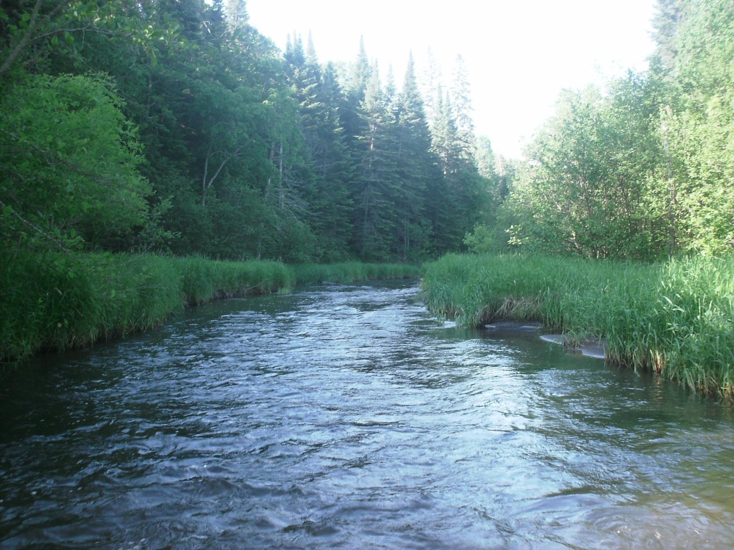
Legislative Water Commission
October 15, 2018
Co-chairs: Senator Wiger Representative Torkelson*
* Presiding
Jim Stark, Director
Straight River, Becker County
1

Slide 2
Legislative Water Commission
Monday, October 15, 2018 (1 pm)
State Office Building: Room 10
Rep. Paul Torkelson, Chair * Sen. Chuck Wiger, Co-Chair
* Presiding
Agenda
Approval of minutes– September 2019 LWC
Legislative recommendations-Jim Stark
Review of Clean Water Goals - Chris Elvrum
Stakeholder testimony: Facilitated (Abra Pollack (MMB))
2019 LWC Recommendations: Representative Torkelson
Next Steps
Future meetings
Adjourn
2

Slide 3
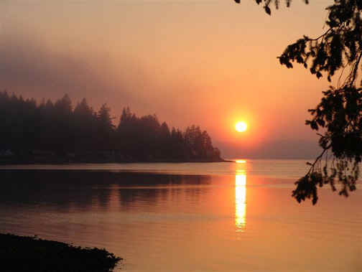
2019 LWC Issues and Recommendations
Notes:
For more information and real time monitoring data you can visit this web site.

Slide 4
Reminder--Six Water Issues
Wastewater/Storm Water
Drinking Water
Groundwater Sustainability
Sustainable Lakes
Water Retention
Future State of Waters
Notes:
Protection of ground water and surface water resources will require substantial investments from a diversity of funding sources over all levels of government during the next decade. As a part of this effort, this program of mapping, monitoring and managing is necessary to deliver the basic understanding of the hydrologic system for both surface and groundwater.

Slide 5
Process
Commission Guidance
Feedback-Governor’s Town Halls
Stakeholder suggestions
Existing documents and reports
Based on those:
Background papers- available
Recommendations by issue- available
Stakeholder meetings and direction
Ranked recommendations (handout
Survey ( 150+)
Consolidation of Recommendations (handout)
Commission consensus
Legislative discussions
Notes:
For more information and real time monitoring data you can visit this web site.

Slide 6
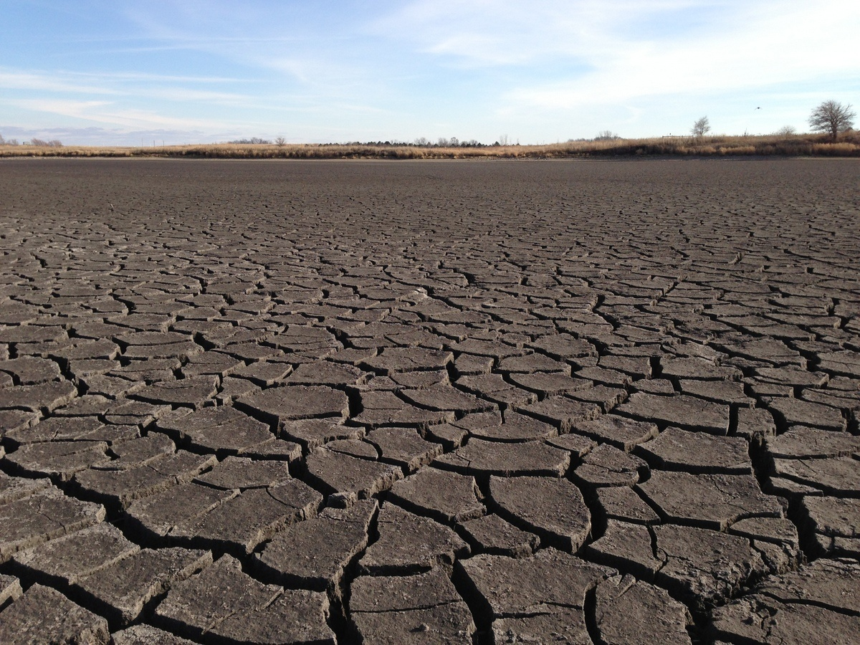
A Firm Foundation
1989- GW Act
1999- USGS Sustainability Report
2004- G16 Impaired Waters Plan (MPCA)
2005- DNR/GW Report
2006- Clean Water Legacy Act
2006- ENRTF Sustainability Report
2008- Clean Water Amendment
2008 Legislative Water Sustainability Framework
2009- EQB Sustainability Report
2012- GW Management Area Plans (DNR)
2017- Freshwater Society Reports on Water Sustainability
(Worthington, MN-2012)

Slide 7
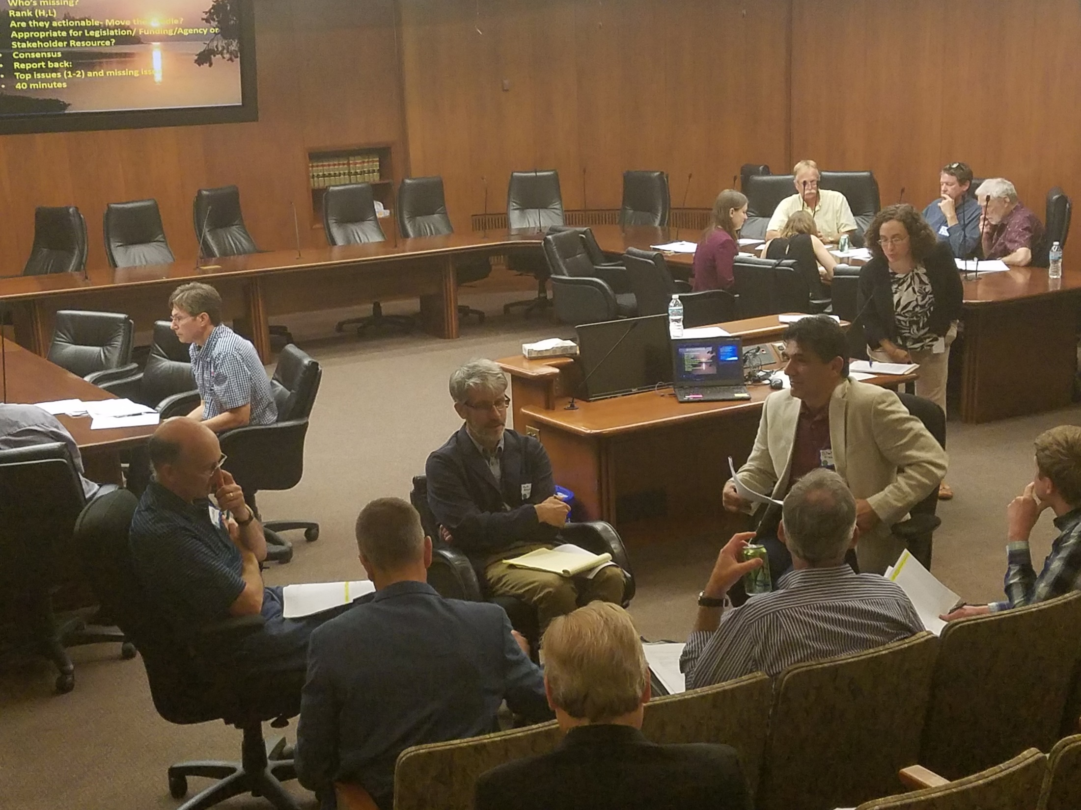
Five Stakeholder Meetings

Slide 8
Outcomes
Detailed Issue Paper (available)
Draft recommendations for each issue (available)
Consolidated and ranked Issues
Notes:
For more information and real time monitoring data you can visit this web site.

Slide 9
Recommendations by Legislative Action
(Provided Document)
9

Slide 10
Thanks!
Survey
Notes:
For more information and real time monitoring data you can visit this web site.

Slide 11
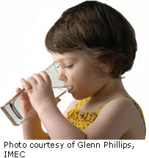
Drinking Water
Enhance Source Water Protection
Water Budgets
Infrastructure Support
Notes:
What we hope to leave you with is a much better understanding of our state’s groundwater resources and appreciation for the challenges we face.
Simply stated the problem we are increasingly recognizing is that there are ….

Slide 12
Groundwater
Maintain and Increase Monitoring, Including Water Budgets
GW Information P
programs
Managed re-use/recharge

Slide 13
Lakes
Policy for Managing Lakes Sustainability
Assess and Prioritize Lakes of Protection
Increase Use of Conservation Easements
Notes:
For more information and real time monitoring data you can visit this web site.

Slide 14
Wastewater and Storm Water
Finances for Aging Infrastructure
Promote Alternative WW Treatment Methods
Address Inflow/Infiltration
Notes:
The issue of interest is the introduction of chemicals into the aquatic environment that can affect aquatic organism or human health. For instance some of the chemicals analyzed act as endocrine disruptors—that is act to change the normal function of the endocrine system in animals.

Slide 15
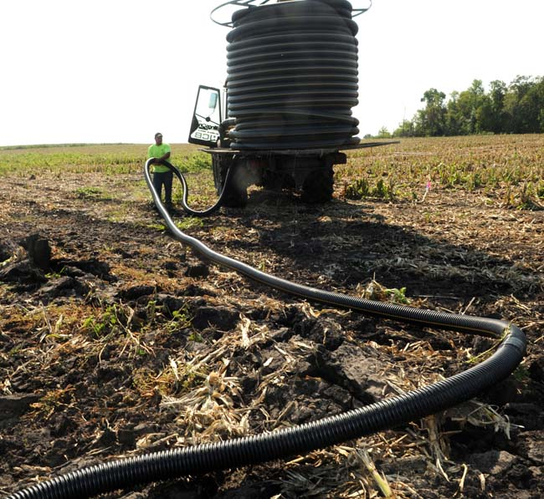
Keeping Water on the Land
Increase: Targeted, Efficient, Incentives for BMPS
Evaluate Extent and Impacts of Tile Drainage

Slide 16
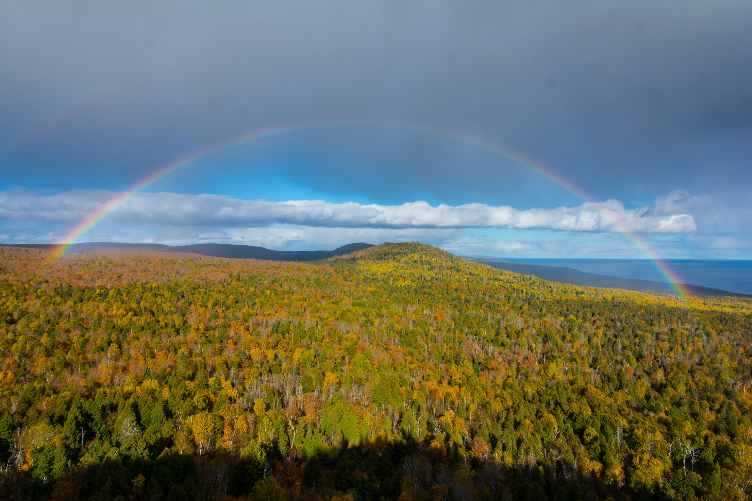
Future State for Water
Water Retention
Monitoring/Information/Education
Promote Healthy Soil/Healthy Water
Notes:
to the northern forests

Slide 17
Thanks!
Survey– what’s between the lines?
Notes:
For more information and real time monitoring data you can visit this web site.

Slide 18
Survey– “Reading Between the Lines”
“
Confirms the stakeholder ranking
Little variation among important recommendations
Aligns with Governor’s Town Hall
Aligns with agency reports
Need to prioritize
Costs, ROI, agency capacity--drivers
Multi-year process

Slide 19
Draft Recommendations
(Provided (white) Document)
Grouped in three bins
19

Slide 20
Group 1: Focused Legislation
Specific targeted topic
Short term
Example: Increase MDH service connection fee

Slide 21
Group 2: Legislation that Adds to Missions of Agencies
s
Broader, more complex issues that supplement existing missions
Longer-term
Example: Expand role of Drainage Working Group, or create equivalent, to address all water retention issues

Slide 22
Group 3: Legislation that Creates New Initiatives
Broad issues
Long term goals
Example: Source-water protection for rivers that supply drinking water

Slide 23
Common Themes
Fits with Governor’s Round Table
Water is a statewide crosscutting issue
Address impact of all land uses
Think long and short term
Good information for decisions-education
Move from assessing to implementing
Prioritize BMPs on the land
Establish realistic targets
Measure results/manage adaptively
Focus on incentives rather
than regulation
Measure results/mange adaptively
Implement locally with
agency direction and oversight
Notes:
For more information and real time monitoring data you can visit this web site.

Slide 24
Clean Water Council Update: Chris Elvrum (MDH)
24

Slide 25
Stakeholder Comments
Notes:
to the northern forests

Slide 26
Commission Recommendations (Provided Document)
26

Slide 27
Next Steps
Revise Issue Statements
Revise Recommendations
Initial Consensus from LWC
Feedback from Stakeholders
Consolidate recommendations into recommendation themes
LWC Consensus
Recommendation Revisions- ROI analysis?
Recommendations to Legislature
Legislative briefings with Environmental Committees/Agency staff

Slide 28
2018 Meeting Schedule
Second round of stakeholder meeting-- October
Future LWC meetings: Discuss meeting times
October 15 ( Recommendation consensus)
November 13 (1 pm) ( Recommendations to Legislature)
December 10

Slide 29
Thanks and Adjourn
Notes:
to the northern forests

